Slide 1
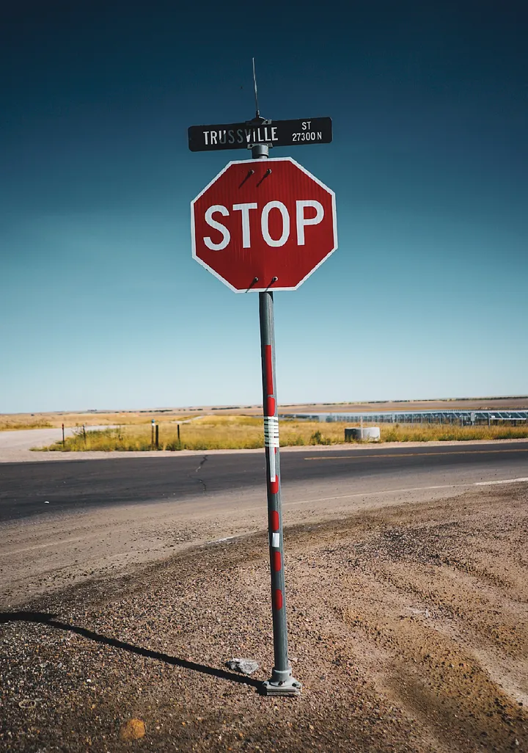
STOP SIGN DETECTION IN STREET IMAGES USING TRADITIONAL Machine Learning Algorithms
GROUP:08: MD. ABU YOUSUF NESHAD, MUBASSHIR SADAT, IRFAN SHAH MAYEEN AND AL AMIN

Slide 2
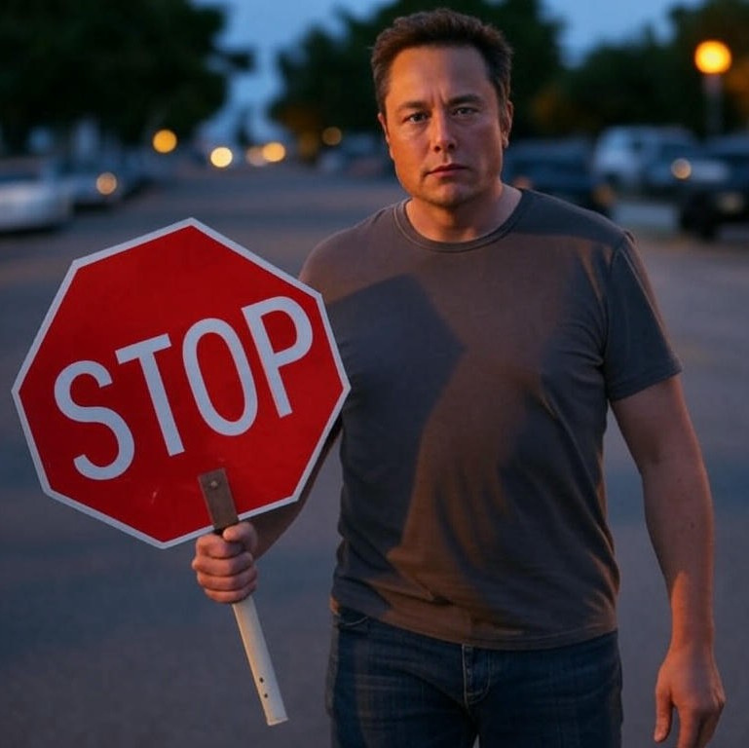
INTRODUCTION
Goal: Detect stop signs using traditional ML
Why: Enhance road safety, and traffic management
Methods: Traditional algorithms (e.g., SVM, Random Forests)
Progress: Data prep, model training, initial testing
Aim: Show practical value of traditional ML
GROUP:08: MD. ABU YOUSUF NESHAD, MUBASSHIR SADAT, IRFAN SHAH MAYEEN AND AL AMIN

Slide 3
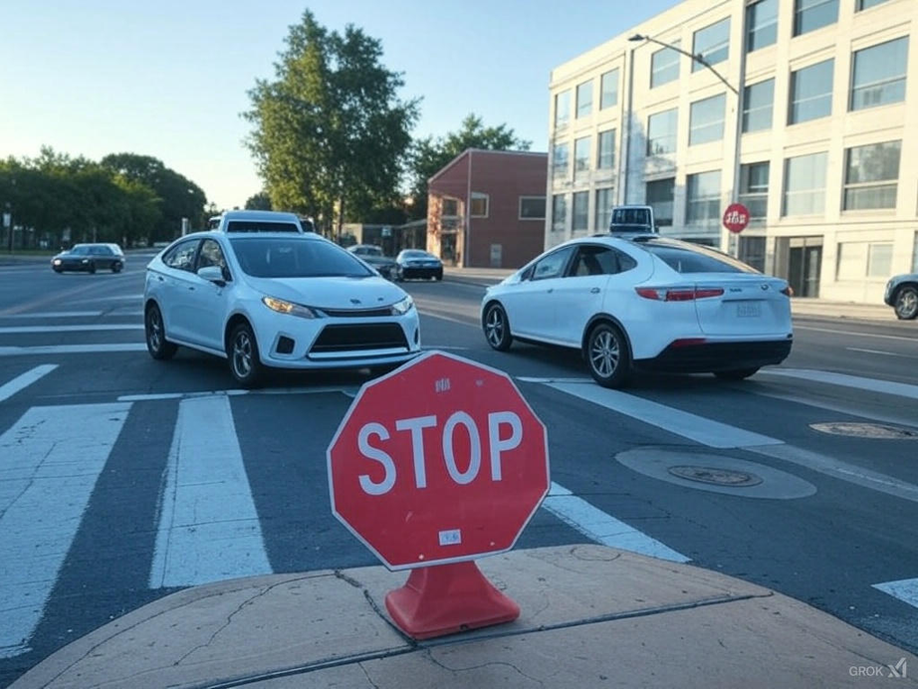
SIGNIFICANCE
Enhances road safety and autonomous navigation
Reduces traffic accidents at intersections
Leverages cost-effective, efficient machine learning
Ensures reliable stop sign detection
GROUP:08: MD. ABU YOUSUF NESHAD, MUBASSHIR SADAT, IRFAN SHAH MAYEEN AND AL AMIN

Slide 4
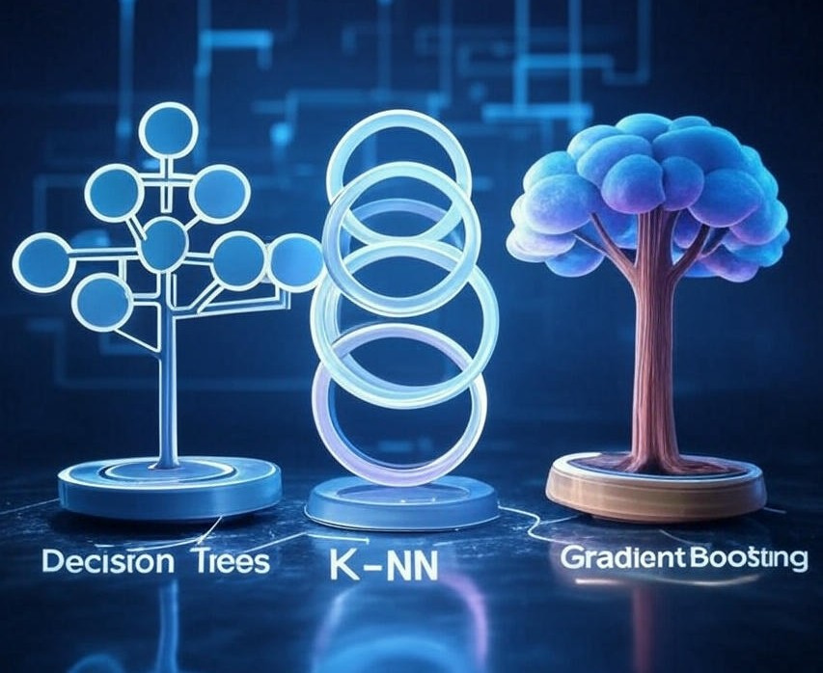
FUTURE WORK
Test more models (e.g., Decision Trees, k-NN, Gradient Boosting)
Compare performance: accuracy, speed, robustness
Identify best model for real-world use
Optimize system for practical deployment
GROUP:08: MD. ABU YOUSUF NESHAD, MUBASSHIR SADAT, IRFAN SHAH MAYEEN AND AL AMIN

Slide 5
CONCLUSION
Built stop sign detection with traditional ML
Initial results show effectiveness
Plan: Test more models, improve accuracy
GROUP:08: MD. ABU YOUSUF NESHAD, MUBASSHIR SADAT, IRFAN SHAH MAYEEN AND AL AMIN

